Slide 1
SIMS
Group Members:
Ary Hernandez
Jacquelyn Johnson
Andrew Samuel
John Andrew Tomich
Julio Quintero

Slide 2
Group Type/Structure
Democratic:
Coined “egoless programming” where finding faults in the code is encouraged.
Mutual respect is crucial
Advantages:
Positive attitude towards progressing the project
High productivity
Works well to come together to fix a hard problem

Slide 3
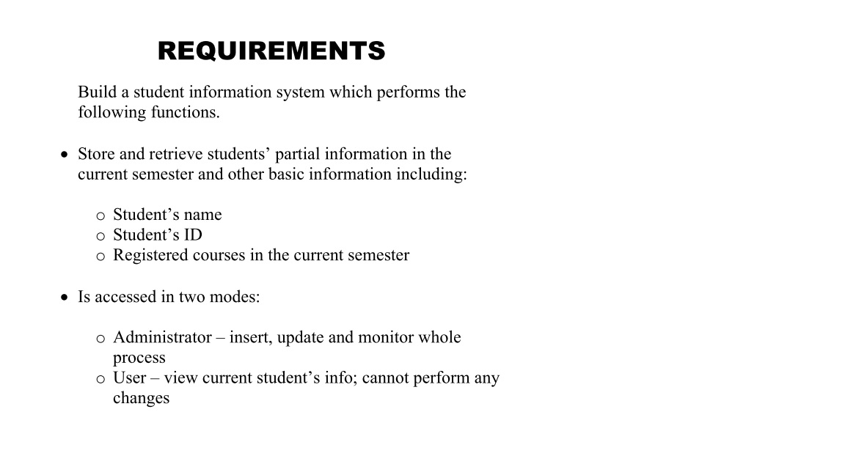
Requirements Documentation

Slide 4
Use-Case Diagram

Slide 5
CRC Description
Below you will see a description of the CRC cards with class descriptions used to design our project software.

Slide 6
mainFrame
Responsibilities | Collaborators
This class is responsible for holding the main frame requiring every user to insert an ID and password to login | This class accesses the Db class and sends data to the Student and AdminFrame classes

Slide 7
Student
Responsibilities | Collaborators
This class receives a value from mainFrame that it uses to display the needed information from the database. Can return to mainFrame class when done viewing | Accesses information from mainFrame and calls needed information from Db

Slide 8
Db
Responsibilities | Collaborators
This class makes connections to the database that holds all user information | This class is called by mainFrame, AdminFrame, and Student.

Slide 9
Login
Responsibilities | Collaborators
This class implements the methods to perform password validation, GPA calculation, and course registration (adding and deleting) | This class is called by mainFrame and AdminFrame

Slide 10
AdminFrame
Responsibilities | Collaborators
This class displays a frame where the admin can view and modify student info with options to add or delete classes and to modify grades | This class is called by mainFrame and accesses the Db and Login class.

Slide 11
Workflow Implementation
Below you will see how we implemented the 5 workflows

Slide 12
Requirement Workflow

Slide 13
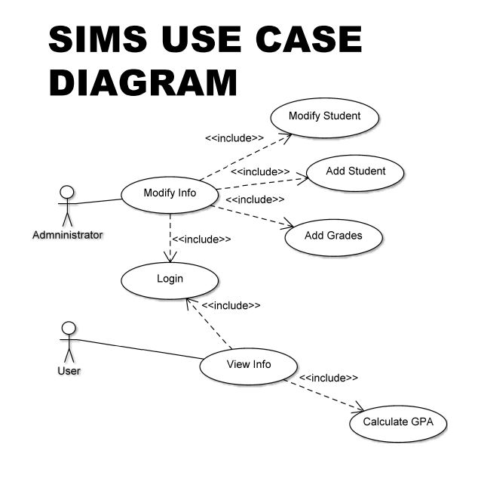
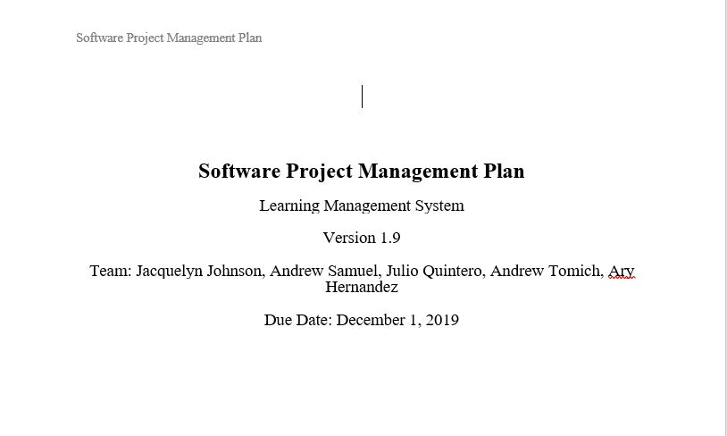
Analysis Workflow

Slide 14
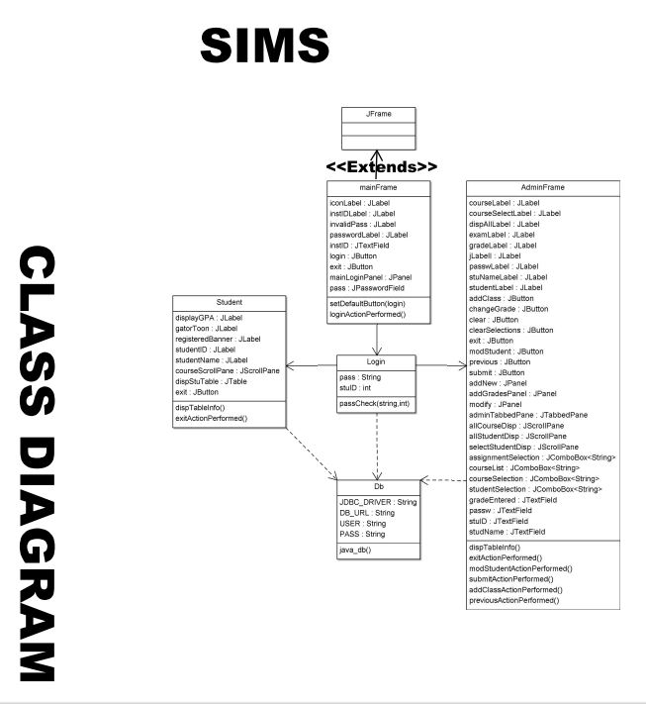
Design Workflow

Slide 15
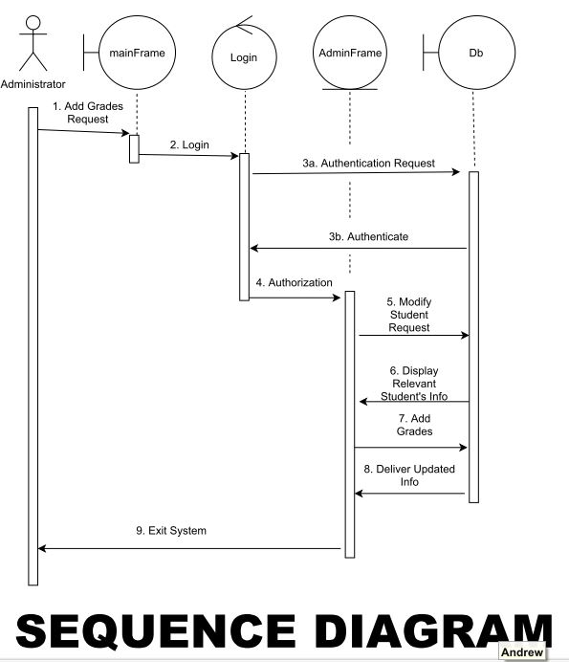
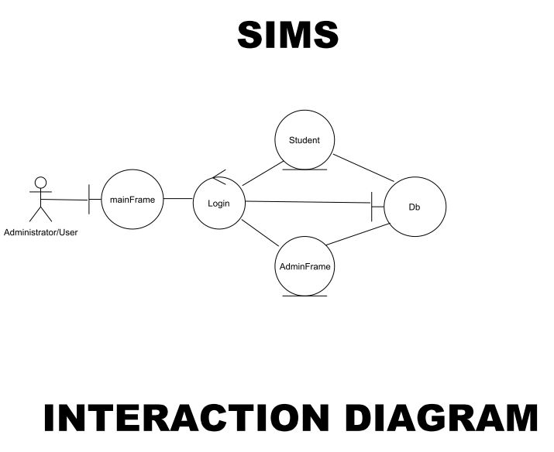
Implementation Workflow

Slide 16
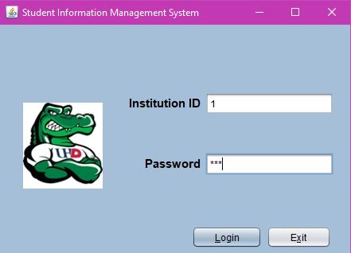
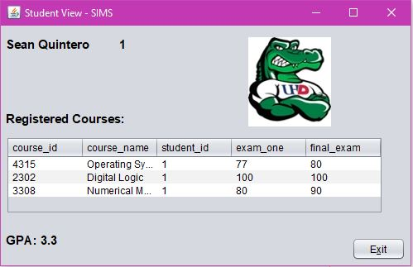
Test Workflow

Slide 17
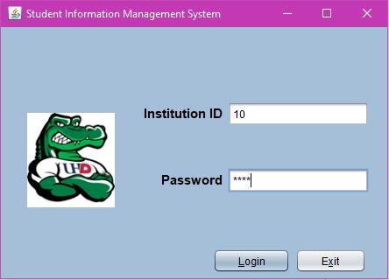
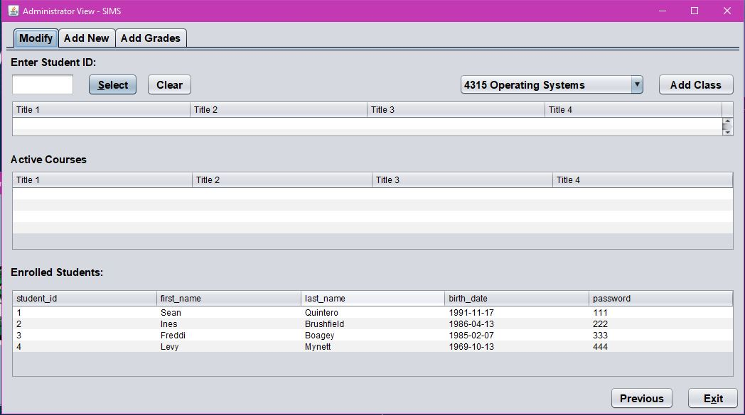
Test Workflow

Slide 18
Code Description
We coded in Java for the GUI/Front End using Netbeans and Eclipse as IDE(s) and for the Back End/Database we used SQL (specifically mySQL)using mySQL Workbench as the IDE
Click me to view SIMS

Slide 19
Thank You

